Slide 1

Emotion Detection from Text Using BERT
A Project on Emotion Recognition via NLP
Presented by: Harshit Singh & Imran Ahmad
Supervisor: Mr. Apoorv Jain | Institute: KIET Group of Institutions | Date: May 2025

Slide 2

Introduction & Motivation
What is Emotion Detection?
Importance
Applications in mental health, customer experience, social analysis
NLP task classifying emotion categories in text data
Motivation
BERT captures deep context beyond traditional methods

Slide 3
Literature Review
Traditional Methods
Deep Learning
BERT Advantages
Lexicon-based
CNNs and RNNs
Bidirectional transformer
SVM, Naive Bayes
Improved but struggled with long sequences
Attention-based contextual embeddings
Limited contextual understanding
Outperforms earlier models

Slide 4

Problem Statement & Objectives
Challenges
Objectives
Ambiguity, mixed emotions, cultural differences
Develop BERT-based emotion classifier
Evaluate on authentic datasets
Visualize emotional trends

Slide 5
Methodology
Data Collection
Preprocessing
Model & Tools
Tweets, GoEmotions dataset, manual labels
Tokenization (WordPiece), cleaning, emoji handling
Fine-tuned bert-base-uncased
Softmax classification layer
Hugging Face, PyTorch, Matplotlib, Tweepy

Slide 6
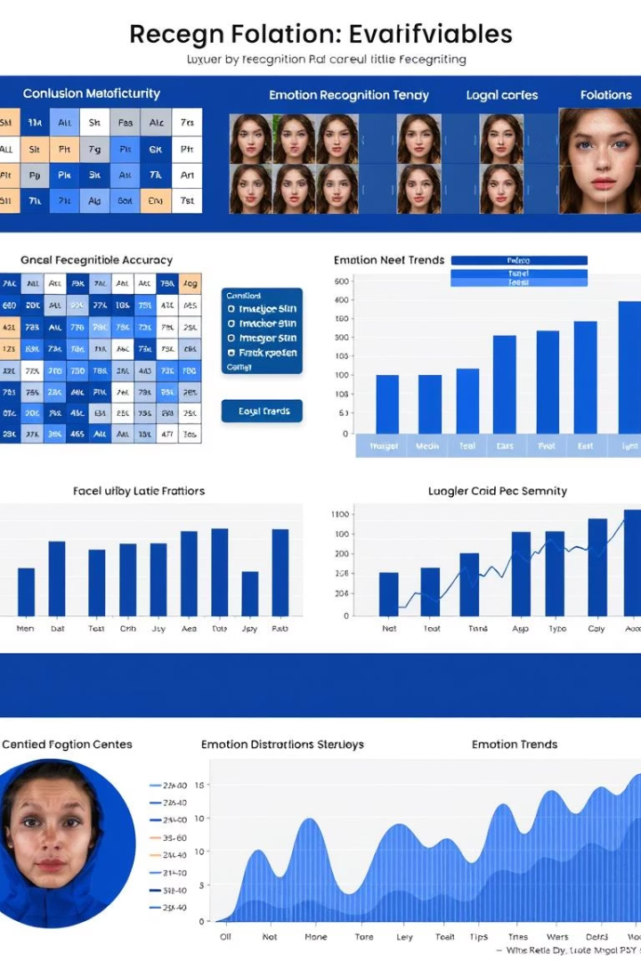
Results & Evaluation
Metrics
Visual Analysis
Accuracy: 89%
Confusion matrix, label distribution, time trends
F1-score (weighted): 0.89
Insights
Strong in Joy/Neutral; some confusion in Fear/Sadness

Slide 7

Future Work & Enhancements
Dataset Expansion
Multi-label Classification
Increase size and diversity
Handle concurrent emotions
Real-time & Multilingual
Deployment & Explainability
Streaming APIs, XLM-RoBERTa integration
Web dashboards, LIME & SHAP interpretability

Slide 8
Conclusion & Applications
Conclusion
Applications
Key Takeaway
BERT improves accuracy and scalability in emotion detection
Sentiment-aware chatbots
Effective, scalable, ready for real-world impact
Real-time social monitoring
Mental health analysis
Personalized content delivery

